Slide 1
Requirement analysis

Slide 2
What is Requirements Analysis?
Requirements Analysis is the process of defining the expectations of the users for an application that is to be built or modified.
Requirements analysis means to analyze, document, validate and manage software or system requirements.

Slide 3
Requirements Analysis Process
The software requirements analysis process involves the following steps/phases:
Eliciting requirements
Analyzing requirements
Requirements modeling
Review and retrospective

Slide 4
Eliciting requirements
The process of gathering requirements by communicating with the customers is known as eliciting requirements.
Analyzing requirements
This step helps to determine the quality of the requirements. It involves identifying whether the requirements are unclear, incomplete, ambiguous, and contradictory. These issues resolved before moving to the next step

Slide 5
Requirements modelling
In Requirements modelling, the requirements are usually documented in different formats such as use cases, user stories, natural-language documents, or process specification.
Review and retrospective
This step is conducted to reflect on the previous iterations of requirements gathering in a bid to make improvements in the process going forward

Slide 6
Requirements Analysis Techniques:
Business process modeling notation (BPMN)
UML (Unified Modeling Language)
Flowchart technique
Data flow diagram
Role Activity Diagrams (RAD)
Gantt Charts
IDEF (Integrated Definition for Function Modeling)
Gap Analysis

Slide 7
Business process modeling notation (BPMN)
This technique is similar to creating process flowcharts, although BPMN has its own symbols and elements. Business process modeling and notation is used to create graphs for the business process.

Slide 8
UML (Unified Modeling Language)
UML consists of an integrated set of diagrams that are created to specify, visualize, construct and document the artifacts of a software system. In UML, graphical notations are used to represent the design of a software project. UML also help in validating the architectural design of the software.

Slide 9
Flowchart technique
A flowchart depicts the sequential flow and control logic of a set of activities that are related.. The flowchart can represent system interactions, data flows, etc. Flow charts are easy to understand and can be used by both the technical and non-technical team members.

Slide 10
Data flow diagram
Data flow diagrams represent the flow of information through a process or a system. It also includes the data inputs and outputs, data stores, and the various subprocess through which the data moves.

Slide 11
Role Activity Diagrams (RAD)
Role-activity diagram (RAD) is a role-oriented process model that represents role-activity diagrams. Role activity diagrams are a high-level view that captures the dynamics and role structure of an organization.

Slide 12
Gantt Charts
Gantt charts used in project planning as they provide a visual representation of tasks that are scheduled along with the timelines. The Gantt charts help to know what is scheduled to be completed by which date. The start and end dates of all the tasks in the project can be seen in a single view.

Slide 13
IDEF (Integrated Definition for Function Modeling)
Integrated definition for function modeling (IDEFM) technique represents the functions of a process and their relationships to child and parent systems with the help of a box. It provides a blueprint to gain an understanding of an organization’s system.

Slide 14
Gap Analysis
Gap analysis is a technique which helps to analyze the gaps in performance of a software application to determine whether the business requirements are met or not. It also involves the steps that are to be taken to ensure that all the business requirements are met successfully

Slide 15
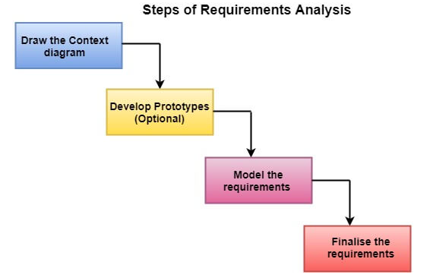

Slide 16
Draw the context diagram:
The context diagram is a simple model that defines the boundaries and interfaces of the proposed systems with the external world. It identifies the entities outside the proposed system that interact with the system.
Development of a Prototype:
One effective way to find out what the customer wants is to construct a prototype, something that looks and preferably acts as part of the system they say they want.

Slide 17
Model the requirements
This process usually consists of various graphical representations of the functions, data entities, external entities, and the relationships between them. The graphical view may help to find incorrect, inconsistent, missing requirements.

Slide 18
Finalise the requirements
After modelling the requirements, we will have a better understanding of the system behaviour. Now we finalize the analysed requirements, and the next step is to document these requirements in a prescribed format.

